Slide 1

DESIGN AND SIMULATION OF A COMPUTER NETWORK FOR A RAILWAY PLATFORM USING CISCO
Submitted to
Shumona Afroz
Lecturer
Dept of CSE
CSE 322
Computer Network Lab

Slide 2



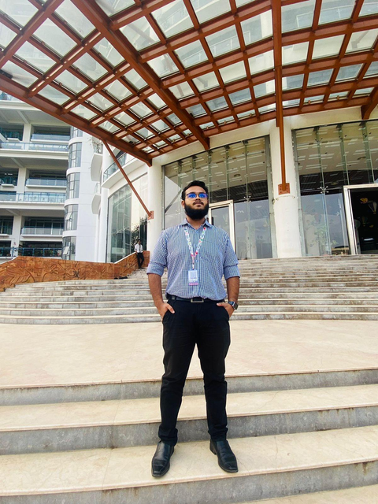
Md Nazmul Islam
0242310005101183
SM Sadman Al Siam
0242310005101123
Masud Rana Nayeem
0242310005101849
Md. Sakib Hossain
0242310005101266

Slide 3
Table of Content
Introduction
Goals & Objective
Background Study
Network Diagram
Tools & Technologies
Expected Outcomes
Conclusion

Slide 4
INTRODUCTION
The purpose of this project is to create a reliable, secure, and efficient computer network for a railway platform using Cisco devices. The network will be divided into sections such as authority, passenger, VIP zone, and the platform. We will be using VLSM to segment the network into smaller parts for better organization and control

Slide 5
GOALS
MAIN GOAL
KEY OBJECTIVE
To design and set up a functional network for a railway platform using Cisco routers, switches, wireless access points, PCs, and laptops while ensuring security and efficient data management.
Create Network Segments,
Internet Access,
Dynamic IP Addressing,
DNS Configuration,
Web Services,
Prioritize Traffic.

Slide 6
BACKGROUND
The railway platform needs a stable and secure network to handle various tasks like passenger ticketing, real-time information boards, and staff communication. With Cisco routers, switches, wireless access points, and services like DHCP, DNS, and HTTP, we can build a network that is both scalable and secure.
GENERAL OVERVIEW
In this project, we will focus on VLSM instead of VLANs to segment the network efficiently. This method will allow us to allocate the exact number of IP addresses needed for each section (authority, passenger, VIP, and platform) based on the network’s requirements.

Slide 7
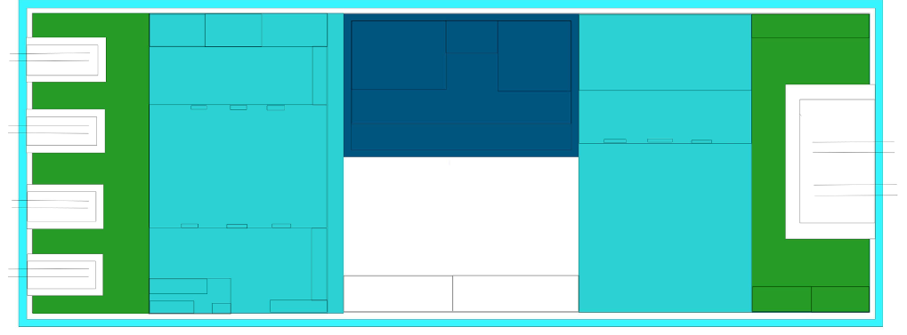
Network Design
Plat
form
Authority
PASSENGERS
PASSENGERS
VIP

Slide 8
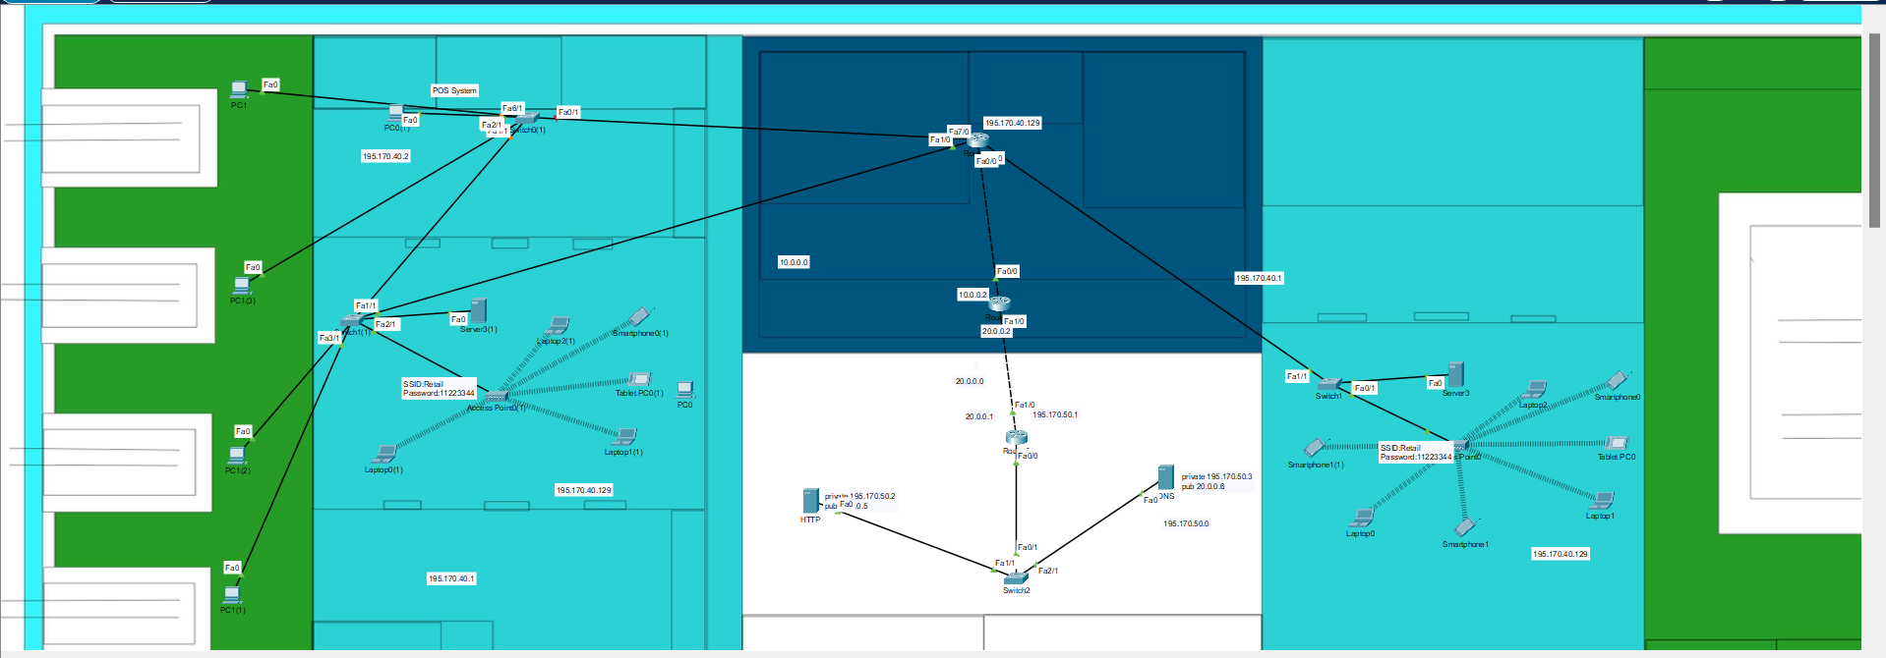
Network Design
Authority
PASSENGERS
PASSENGERS
VIP

Slide 9




TOOLS AND TECHNOLOGY
Images | Devices
 | Switch
 | Router
 | Wireless Router
 | Laptop and PCs
 | Devices
 | DHCP
 | DNS
 | HTTP
 | Technique
 | VLSM
 | QoS
 | Wireless Router

Slide 10
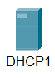
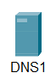
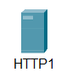
TOOLS AND TECHNOLOGY
Images | Devices
 | DHCP
 | DNS
 | HTTP
 | Devices
 | Switch
 | Router
 | Wireless Router
 | PCs
 | Devices
 | VLSM
 | QoS
 | Wireless Router

Slide 11
TOOLS AND TECHNOLOGY
 | Techniques
 | VLSM
 | QoS
 | VLAN
 | Devices
 | Switch
 | Router
 | Wireless Router
 | PCs
 | Devices
 | DHCP
 | DNS
 | HTTP

Slide 12
EXPECTED OUTCOMES
Network Design Documentation
Network Configuration Files
Simulation Results

Slide 13
CONCLUSION
This project will create a reliable, efficient network for a railway platform using Cisco devices and VLSM for network segmentation. The network will provide secure communication for staff, Wi-Fi access for passengers, and real-time information updates, all while ensuring optimal use of IP addresses

Slide 14
THANK YOU

